Slide 1
This powerpoint file contains a summary repertory of the models available with the QNM solver QNMEig.
If you develop your own models with the solver and wish to make them available, you may propose a summary with the reference to the original publication and your email address, so that potential users may contact you directly.
Please address your ppt summary sheet to philippe.lalanne@institutoptique.fr
plasmonic nanocavities ……………………………………………………… p 2
photonic microcavities & particles ..……………………………………. p 8
gratings and crystals ……………………………………………………..…… p 12

Slide 2
plasmonic nanocavities

Slide 3
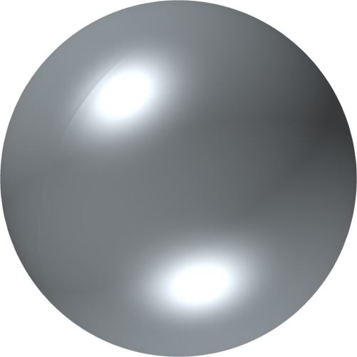
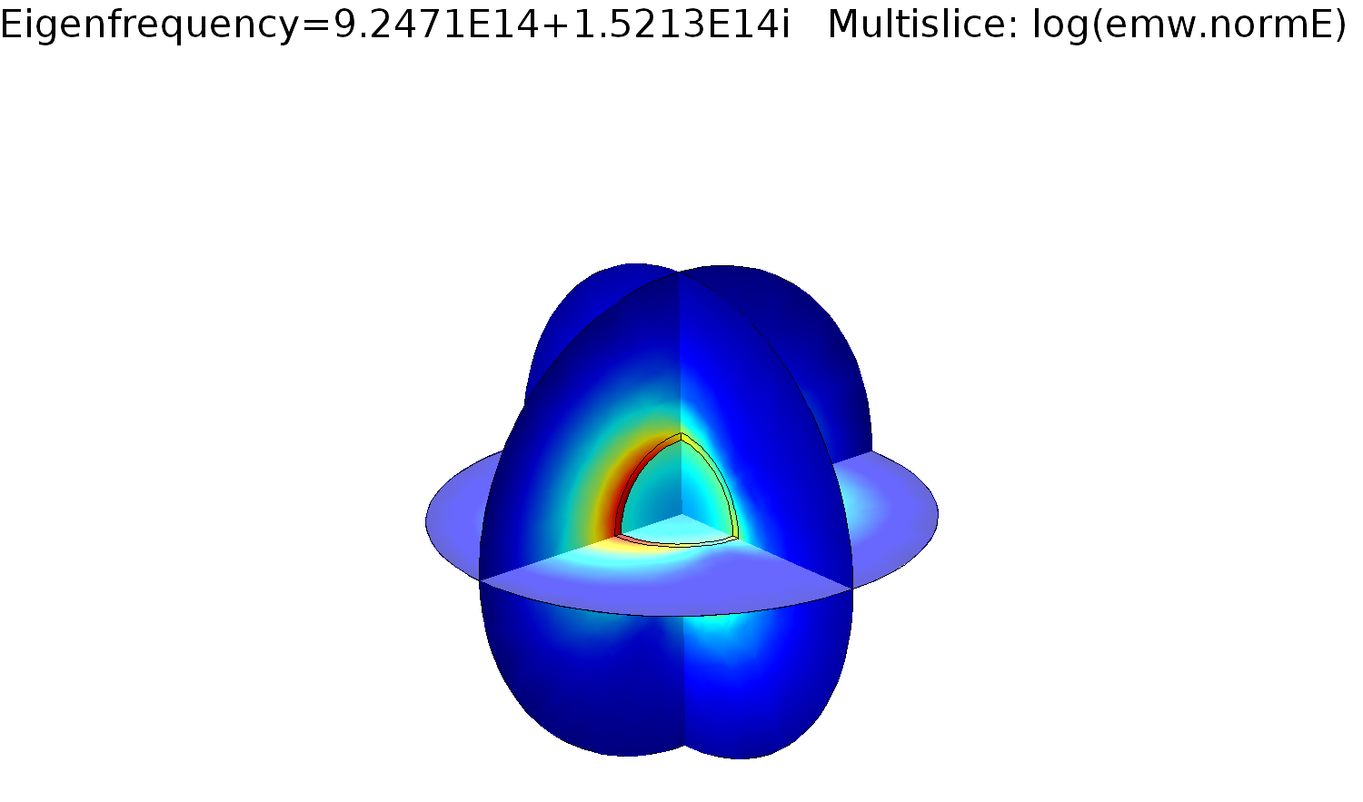
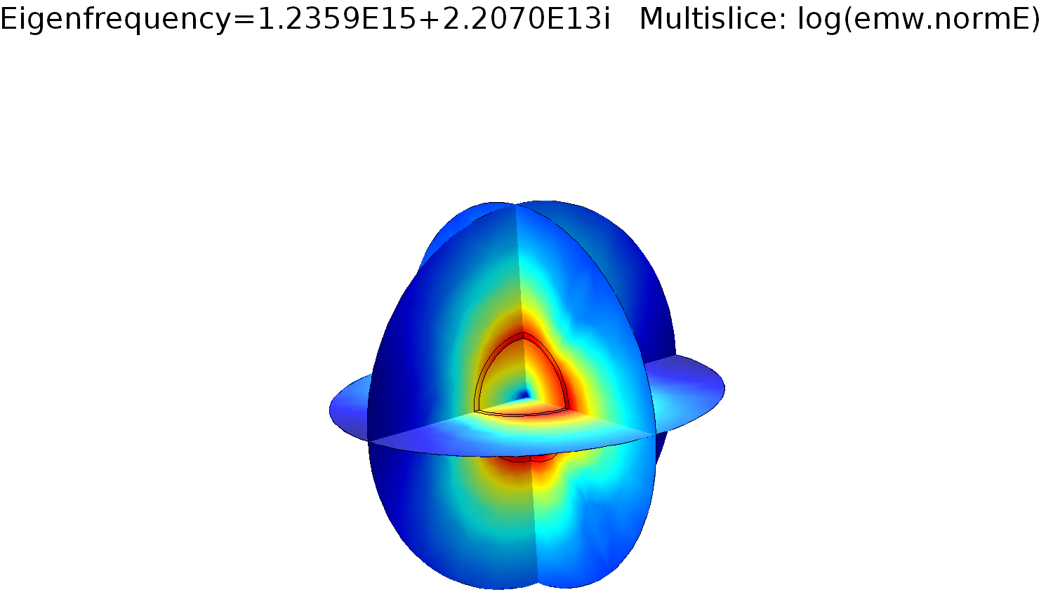

$$ε_{Ag}=ε_{∞}−\frac{ω_{p}^{2}}{ω\left(ω+iγ\right)}$$
Silver sphere in air
Contact: Wei Yan <yanwei@westlake.edu.cn>
Ag
COMSOL model available on the website:
“QNMEig_Sphere.mph’’
air
W. Yan , R. Faggiani, P. Lalanne, Phys. Rev. B 97, 205422 (2018).
"Rigorous modal analysis of plasmonic nanoresonators"
Notes:
Developed by Wei Yan (2018)

Slide 4
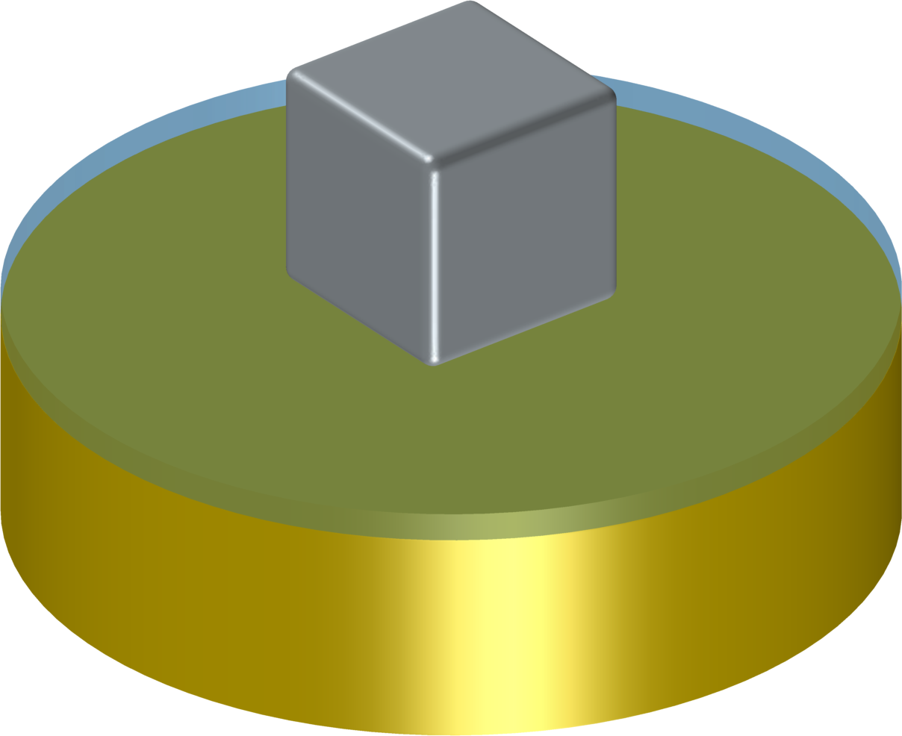
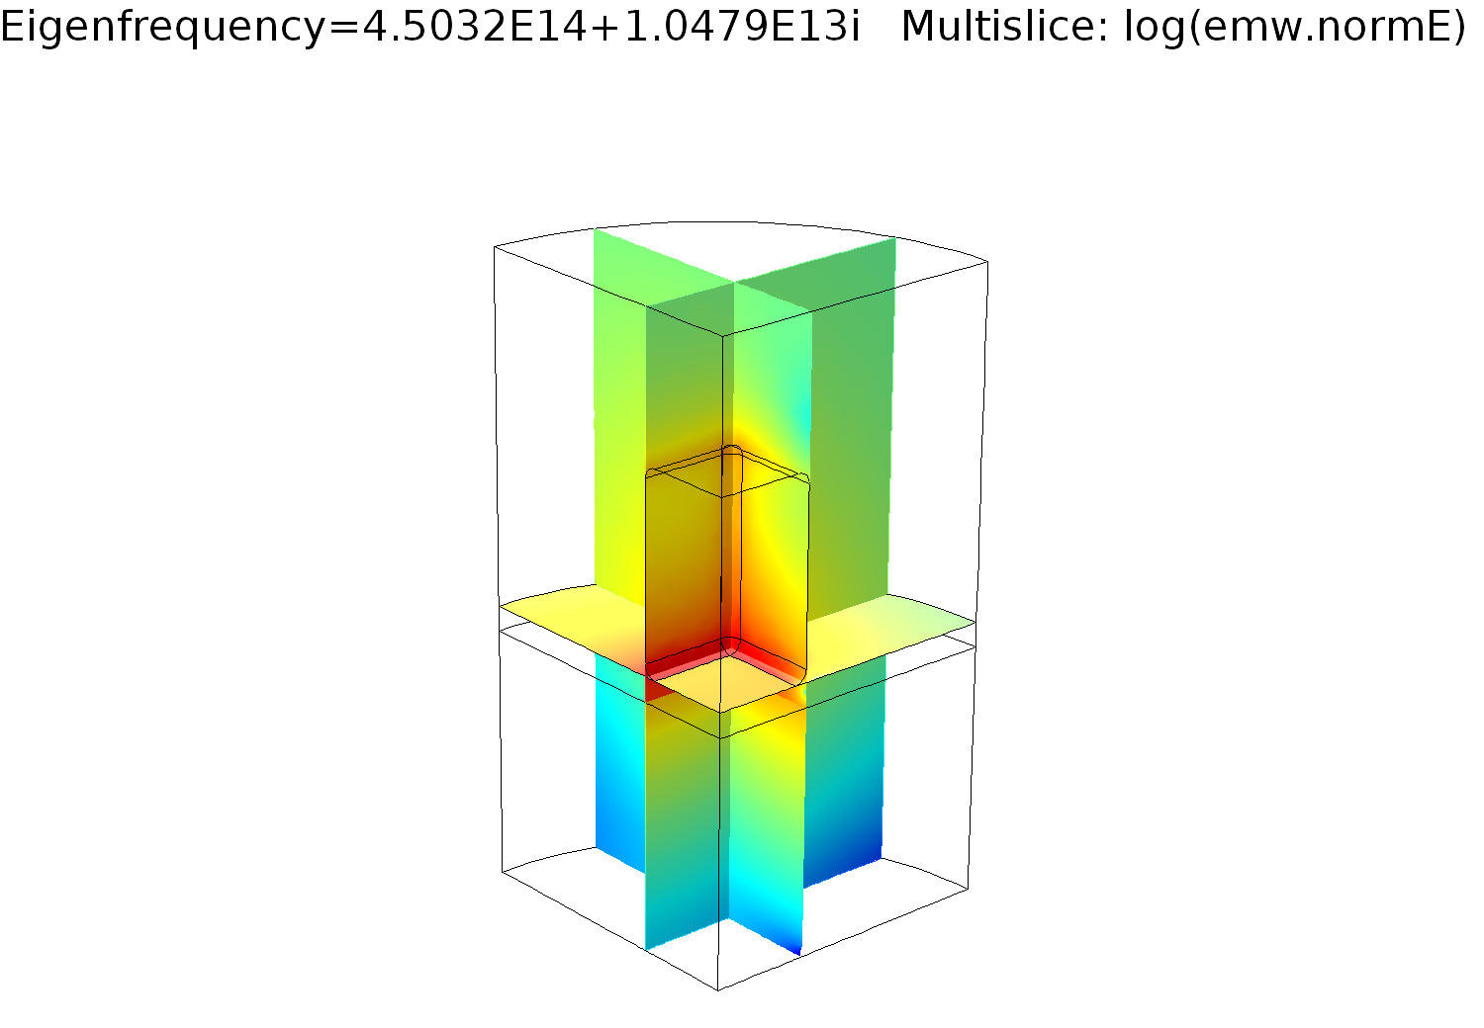
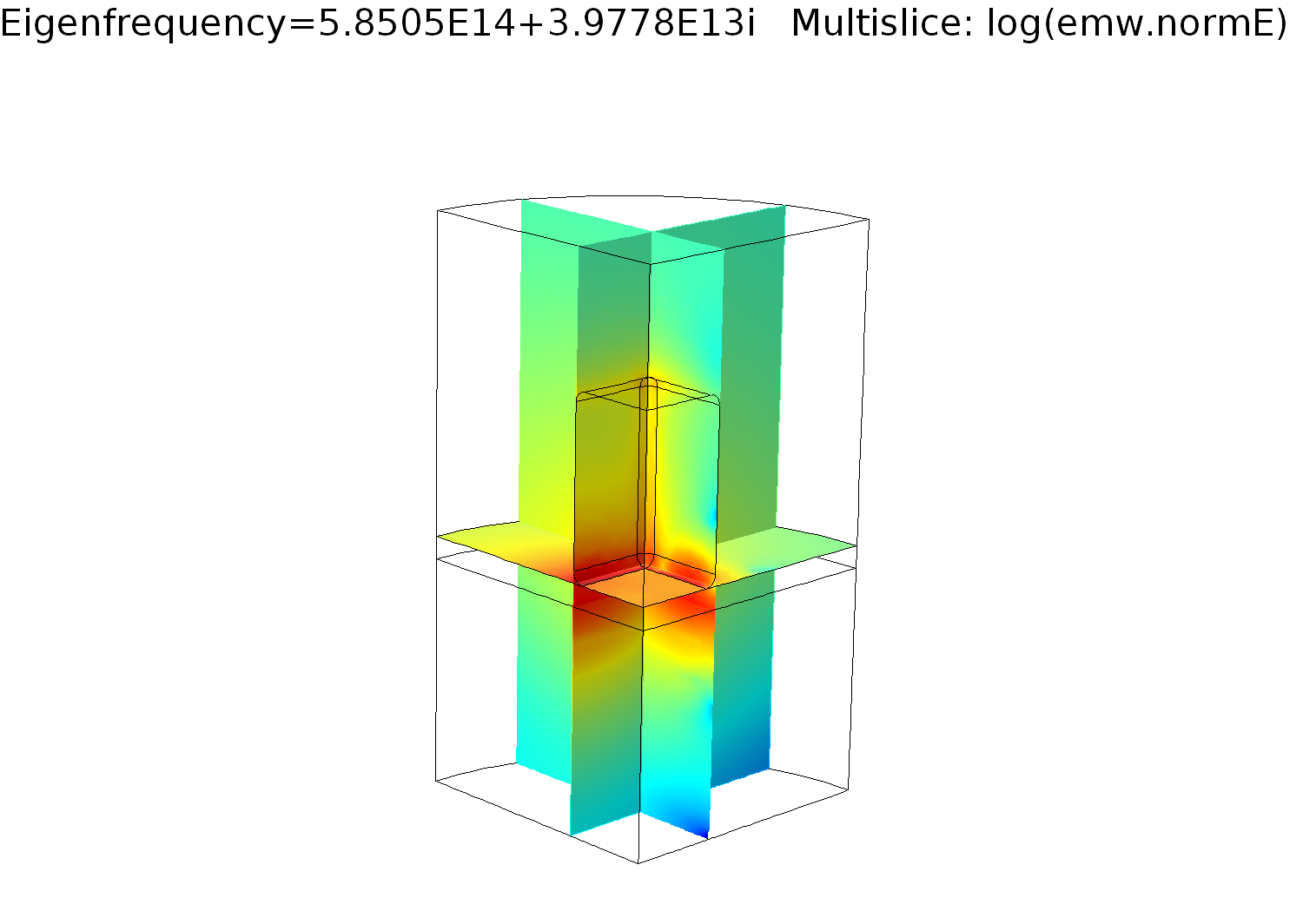


$$ε_{Ag}=ε_{∞}−\frac{ω_{p}^{2}}{ω\left(ω+iγ\right)}$$
Silver nanocube on a coated gold substrate
Ag
Contact: Wei Yan <yanwei@westlake.edu.cn>
COMSOL model available on the website:
“QNMEig_Cubesubstrate.mph’’
Au substrate
thin insulator layer
$$ε_{Au}=ε_{∞}−\frac{ω_{p}^{2}}{ω\left(ω+iγ\right)}−\frac{{Aω}_{1}^{2}}{ω^{2}−ω_{1}^{2}+iγ_{1}}$$
nanocube in air
thin layer
Au substrate
P. Lalanne, W. Yan, A. Gras, C. Sauvan, J.-P. Hugonin, M. Besbes, G. Demesy, M. D. Truong, B. Gralak, F. Zolla, A. Nicolet, F. Binkowski, L. Zschiedrich, S. Burger, J. Zimmerling, R. Remis, P. Urbach, H. T. Liu, T. Weiss, J. Opt. Soc. Am. A 36, 686 (2019).
"Quasinormal mode solvers for resonators with dispersive materials"
Notes:
Developed by Wei Yan (2018)

Slide 5
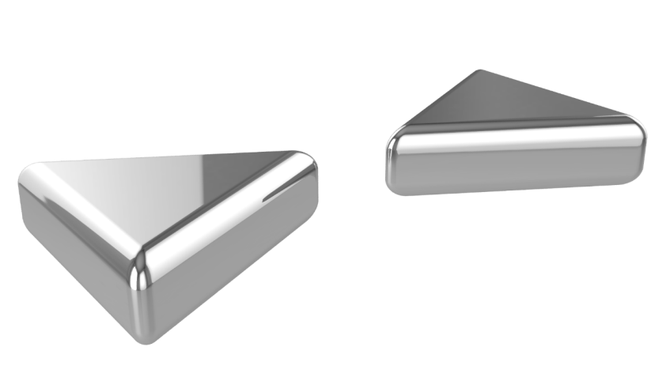
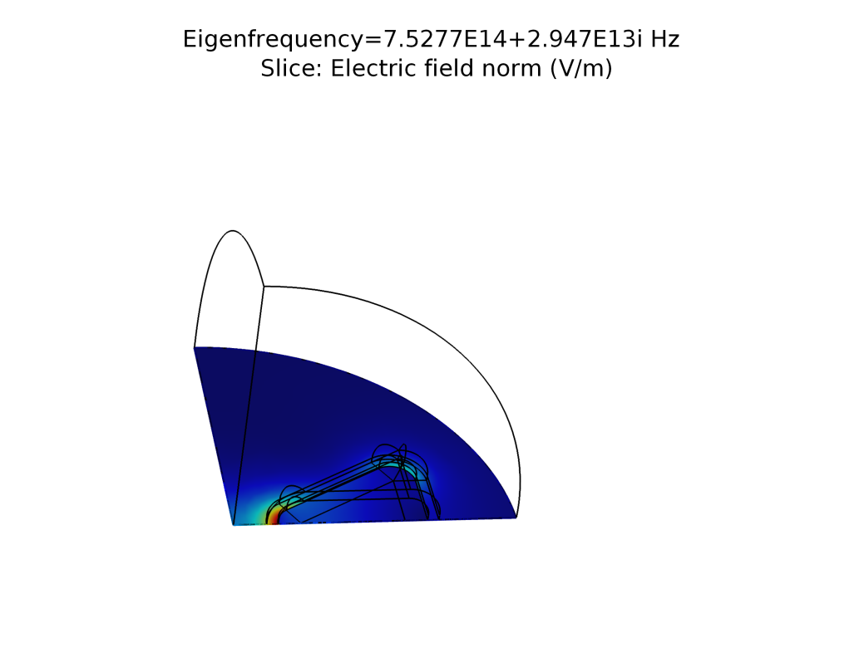
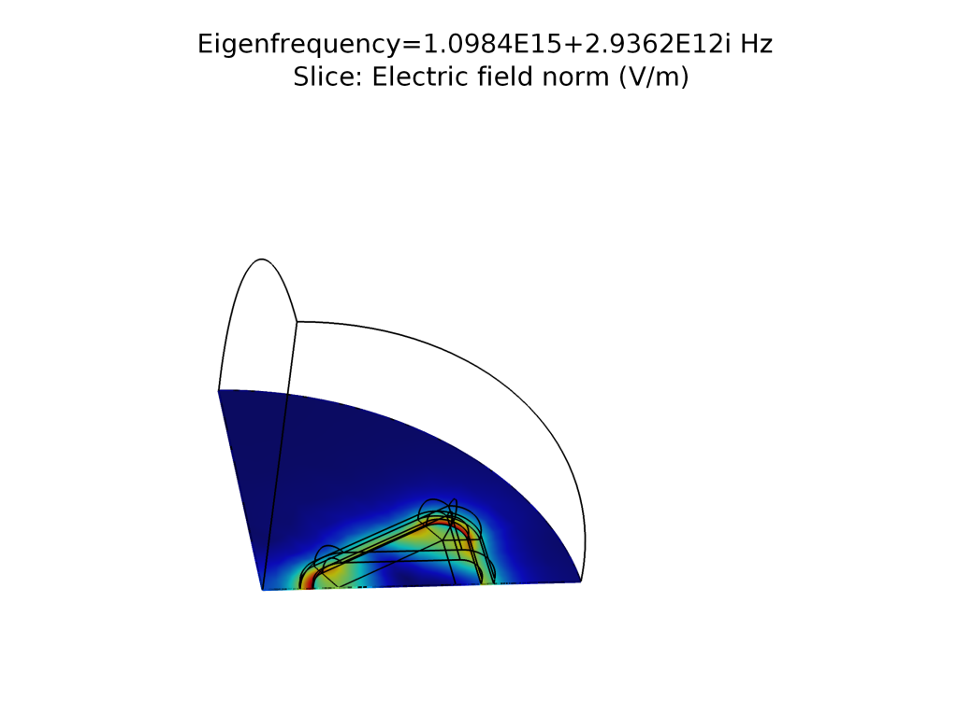

Silver bowtie in air
air
Ag
Contact: Wei Yan <yanwei@westlake.edu.cn>
$$ε_{Ag}=ε_{∞}−\frac{ω_{p}^{2}}{ω\left(ω+iγ\right)}$$
COMSOL model available on the website:
“QNMEig_bowtie.mph’’
W. Yan , R. Faggiani, P. Lalanne, Phys. Rev. B 97, 205422 (2018).
"Rigorous modal analysis of plasmonic nanoresonators"

Slide 6
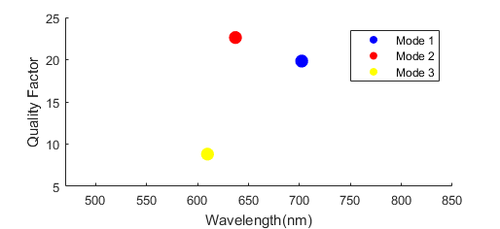

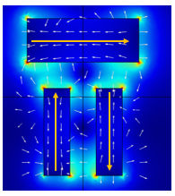
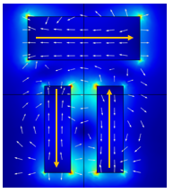
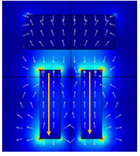

Dolmen nanoantenna
COMSOL model available on the website:
“QNM_Dolmen.mph’’
“QNM_Dolmen_sym.mph’’
or associated matlab files
Ag
air
Eigen electric field distributions
$$ε_{Ag}=ε_{∞}−\frac{ω_{p}^{2}}{ω\left(ω+iγ\right)}$$
Mode1
Mode2
Mode3
R. Faggiani, A. Losquin, J. Yang, E. Mårsell, A. Mikkelsen, P. Lalanne, ACS Photonics 4, 897-904 (2017).
"Modal analysis of the ultrafast dynamics of optical nanoresonators"
T. Wu, A. Baron, P. Lalanne, K. Vynck, arXiv:1907.04598
"Intrinsic multipolar contents of nanoresonators for tailored scattering"

Slide 7
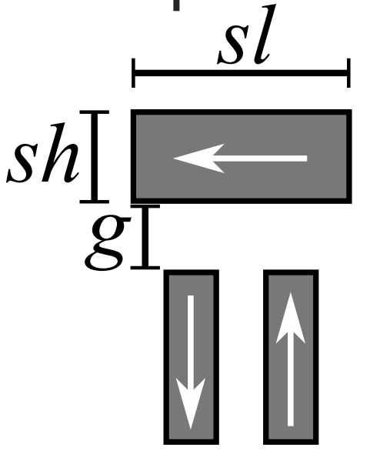
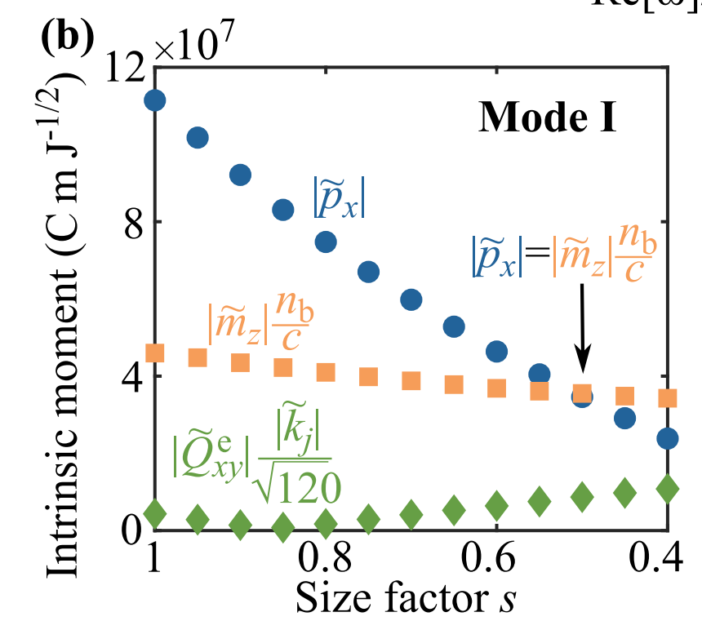
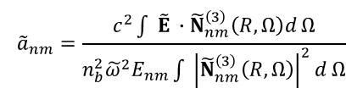
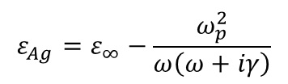



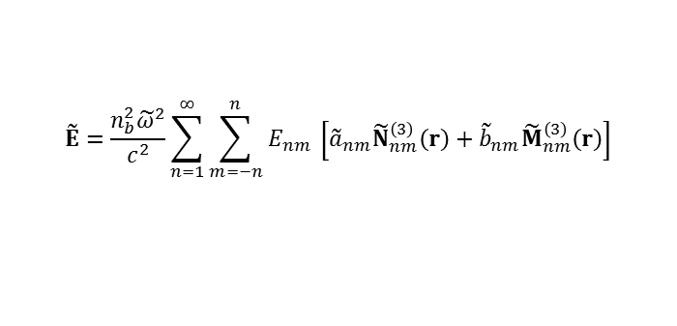
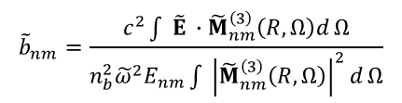
Multipolar decomposition of QNMs
Contact: Tong WU tong.wu@institutoptique.fr or wutong1121@sina.com
$$ε_{Ag}=ε_{∞}−\frac{ω_{p}^{2}}{ω\left(ω+iγ\right)}$$
COMSOL model available on the website:
“QNM_Dolmen.mph’’
“QNM_Dolmen_sym.mph’’
or associated matlab files
$${\tilde{a}}_{nm}=\frac{c^{2}\int{ \tilde{E} ∙{\tilde{N}}_{nm}^{\left(3\right)}\left(R, Ω\right)d}Ω}{{n_{b}^{2}\tilde{ω}}^{2}E_{nm}\int{ {\left|{\tilde{N}}_{nm}^{\left(3\right)}\left(R, Ω\right)\right|}^{2}d}Ω}$$
$${\tilde{p}}_{x}$$
$${\tilde{m}}_{z}$$
$${\tilde{b}}_{nm}=\frac{c^{2}\int{ \tilde{E} ∙{\tilde{M}}_{nm}^{\left(3\right)}\left(R, Ω\right)d}Ω}{{n_{b}^{2}\tilde{ω}}^{2}E_{nm}\int{ {\left|{\tilde{M}}_{nm}^{\left(3\right)}\left(R, Ω\right)\right|}^{2}d}Ω}$$
$${\tilde{Q}}_{xy}^{e}$$
$$\tilde{E}=\frac{{n_{b}^{2}\tilde{ω}}^{2}}{c^{2}}\sum_{n=1}^{∞}{\sum_{m=−n}^{n}{E_{nm} }\left[{\tilde{a}}_{nm}{\tilde{N}}_{nm}^{\left(3\right)}\left(r\right)+{\tilde{b}}_{nm}{\tilde{M}}_{nm}^{\left(3\right)}\left(r\right)\right]}$$
T. Wu, A. Baron, P. Lalanne, K. Vynck, arXiv:1907.04598
"Intrinsic multipolar contents of nanoresonators for tailored scattering"

Slide 8
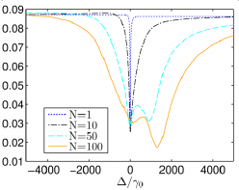

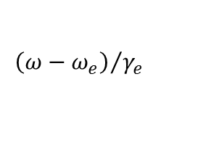
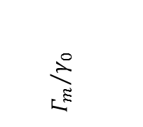
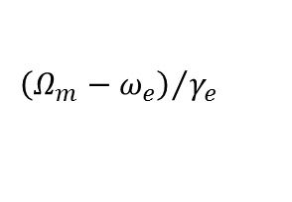

Superradiance of disordered ensembles of two-level resonators coupled by a plasmonic resonator
Ag
Contact: Philippe Lalanne<philippe.lalanne@institutoptique.fr>
Program to compute the superradiant and subradiant states of the coupled ensemble is available in PRB 95, 195418 (2017).
Driving field
$${ω_{e},γ}_{e}$$
Superradiant state
Plasmon-mediated
$${Γ_{m}}/{γ_{0}}$$
$$extinction$$
direct
$${\left(ω−ω_{e}\right)}/{γ_{e}}$$
$${\left(Ω_{m}−ω_{e}\right)}/{γ_{e}}$$
P. Fauché et al., Phys. Rev. B 95, 195418 (2017).
"Collective scattering in hybrid nanostructures with many atomic oscillators coupled to an electromagnetic resonance"

Slide 9
photonic microcavities and particles

Slide 10
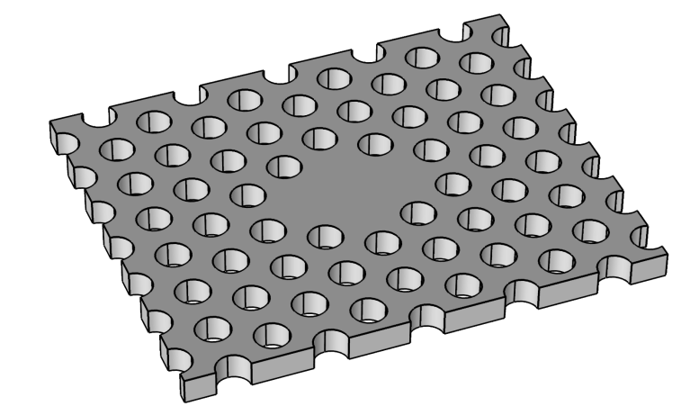
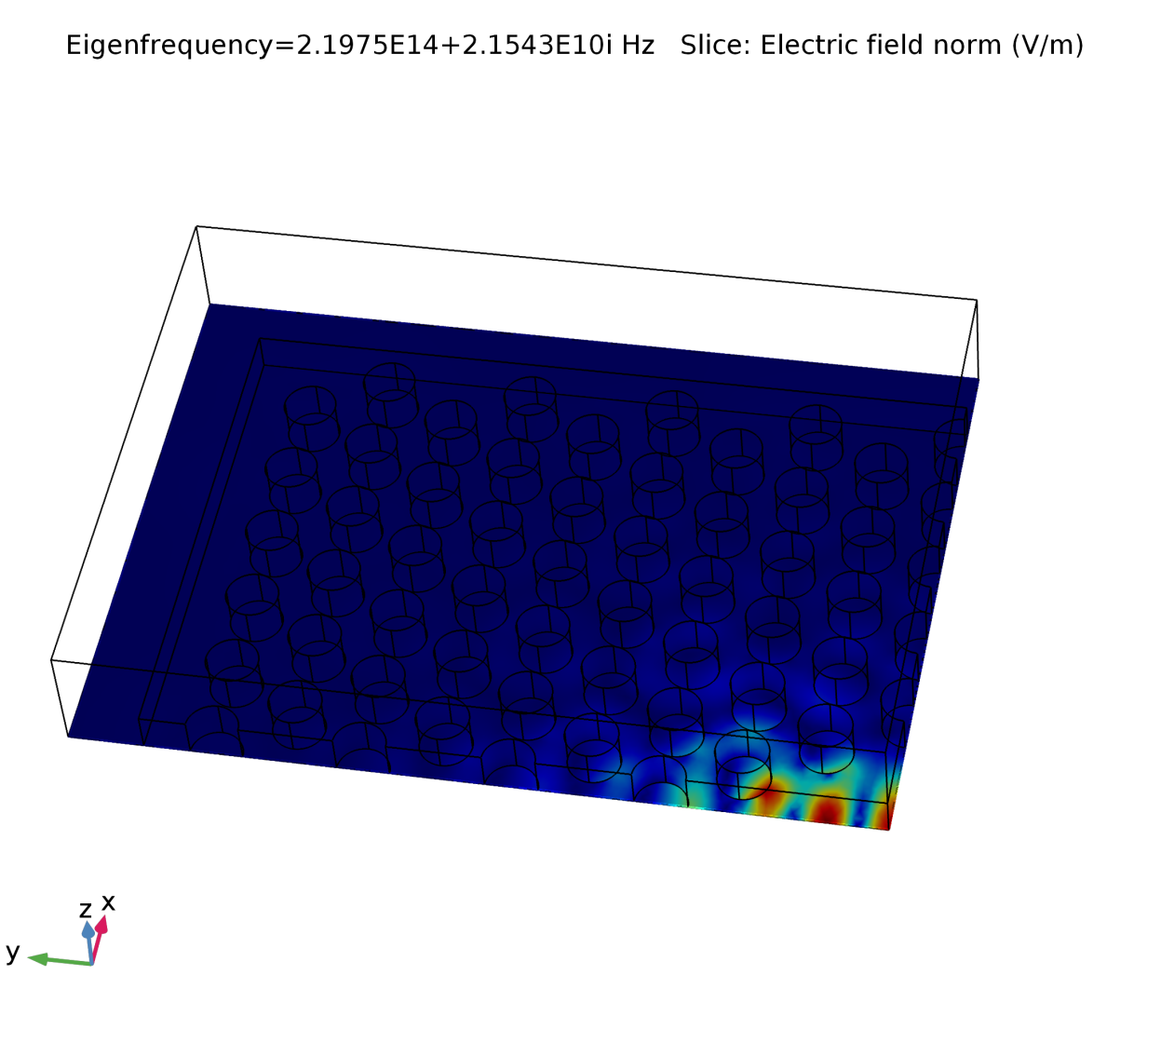
GaAs photonic crystal membrane in air
Contact: Wei Yan <yanwei@westlake.edu.cn>
air
COMSOL model available on the website:
“QNMEig_GaAsPhc.mph’’
GaAs
(no frequency dispersion)
K. G. Cognée, W. Yan, F. La China, D. Balestri, F. Intonti, M. Gurioli, A. F. Koenderink, and P. Lalanne, Optica 6, 269 (2019).
"Mapping Complex Mode Volumes with Cavity Perturbation Theory"

Slide 11
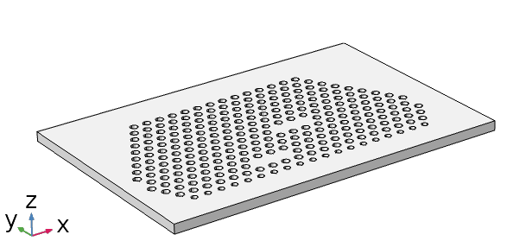
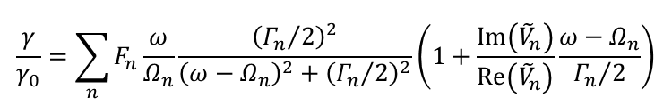


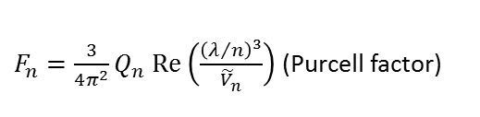



Coupled photonic crystal cavities
Contact: Tong WU<tong.wu@institutoptique.fr>
$$(p=pe_{y})$$
COMSOL model available on the website:
“QNMEig_PhCcoupled.mph’’
November 2019
Normalized LDOS ($γ/γ_{0})$
$$\frac{γ}{γ_{0}}=\sum_{n}{F_{n}\frac{ω}{Ω_{n}}\frac{{\left({Γ_{n}}/2\right)}^{2}}{{\left(ω−Ω_{n}\right)}^{2}+{\left({Γ_{n}}/2\right)}^{2}}\left(1+\frac{Im\left({\tilde{V}}_{n}^{ }\right)}{Re\left({\tilde{V}}_{n}^{ }\right)}\frac{ω−Ω_{n}}{{Γ_{n}}/2}\right)}$$
$F_{n}=\frac{3}{4π^{2}}Q_{n} Re\left(\frac{{\left(λ/n\right)}^{3}}{{\tilde{V}}_{n}^{ }}\right)$ (Purcell factor)
n_air=1
n_slab=3.484
$${\tilde{V}}_{n}^{ }\left(r\right)={\left[{2ε}_{o}ε\left(r\right){\left({\tilde{E}}_{n}\left(r\right)∙u\right)}^{2}\right]}^{−1}$$
$$Q_{n}=−\frac{Re\left({\tilde{ω}}_{n}\right)}{2Im\left({\tilde{ω}}_{n}\right)}=\frac{Ω_{n}}{Γ_{n}}$$
Cavity 2
$$γ_{0}=\frac{ω^{3}n}{3πε_{0}c^{3}ℏ}{\left|p\right|}^{2}$$
Cavity 1
Suppl. Information: C. Sauvan, J.P. Hugonin, I.S. Maksymov, and P. Lalanne, Phys. Rev. Lett. 110, 237401 (2013).
"Theory of the spontaneous optical emission of nanosize photonic and plasmon resonators"

Slide 12
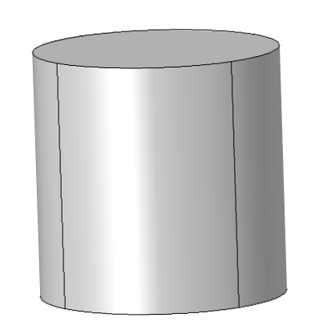
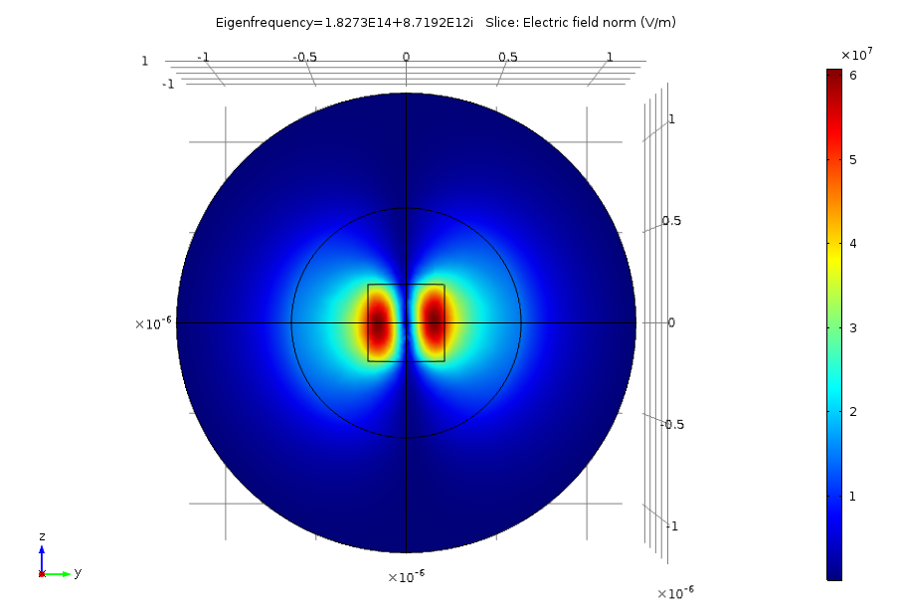


Semiconductor nanorod in air
Contact: Alexandre Gras <alexandre.gras@institutoptique.fr>
COMSOL model available on the website:
“QNMEig_Nanorod.mph’’
January 2019
air
Si
$$ε_{Si}=Cte$$
Electric-field norm of mode with $\tilde{λ}=1.$652-0.8211i µm
The extinction computed with the QNM-expansion is obtained with the toolbox QNMEig_toolbox_1 for an incident plane wave that propagates parallel to the rod axis.
Notes:
Developed by Wei Yan (2018)

Slide 13
gratings and crystals

Slide 14
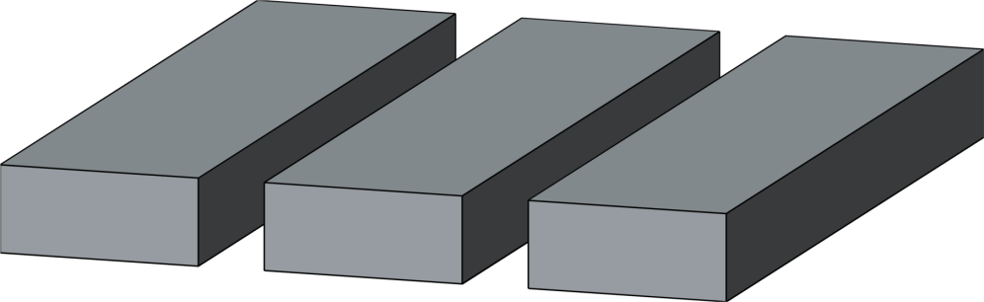

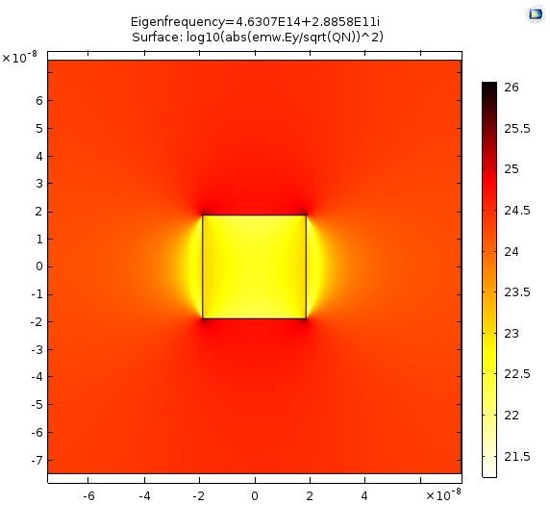
2D plasmonic crystal
air
Contact: Wei Yan <yanwei@westlake.edu.cn>
COMSOL model available on the website:
“QNMEig_PlasmCrystal.mph’’
Ag
y
x
QNMs are computed and normalized for in plane parallel momentum k//.
Eigenmode k_{x}=0.5
P. Lalanne, W. Yan, A. Gras, C. Sauvan, J.-P. Hugonin, M. Besbes, G. Demesy, M. D. Truong, B. Gralak, F. Zolla, A. Nicolet, F. Binkowski, L. Zschiedrich, S. Burger, J. Zimmerling, R. Remis, P. Urbach, H. T. Liu, T. Weiss, J. Opt. Soc. Am. A 36, 686 (2019).
"Quasinormal mode solvers for resonators with dispersive materials"
Notes:
Developed by Alexandre Gras (2018)

Slide 15
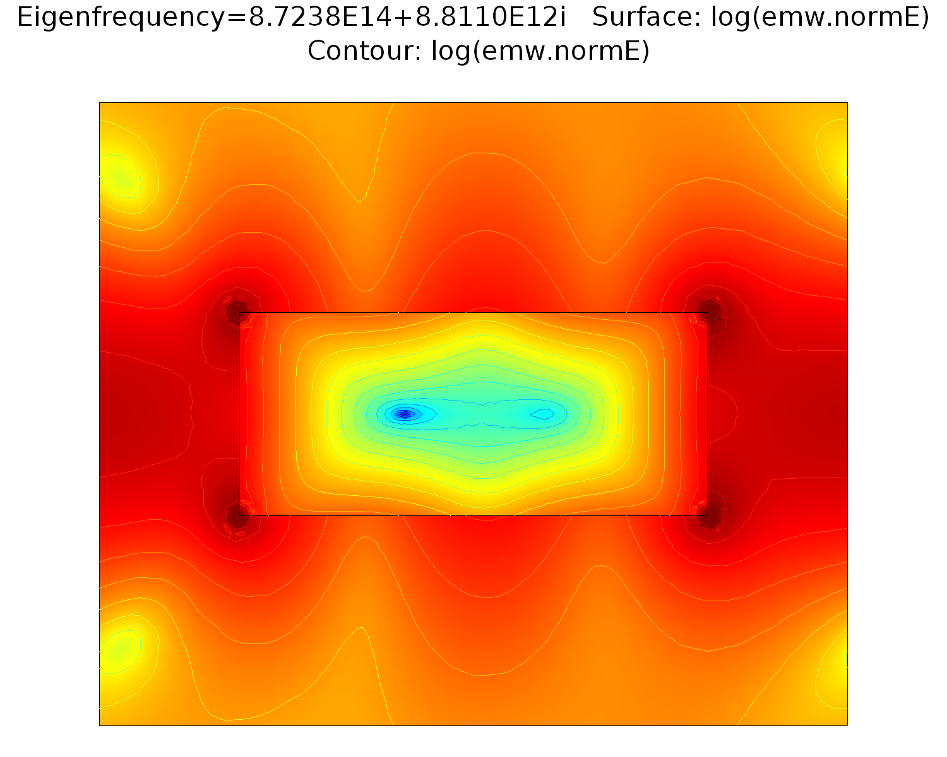
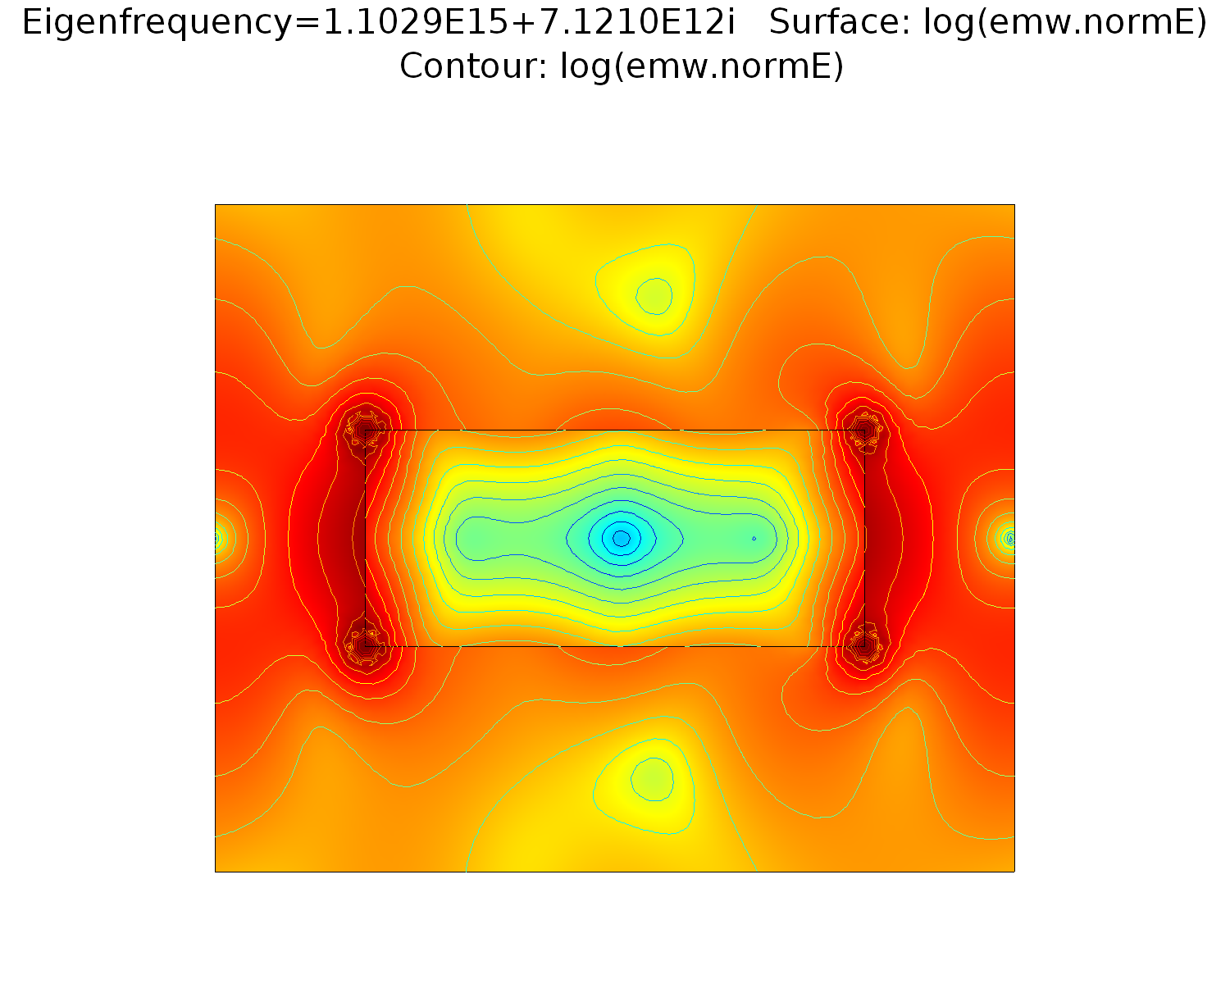
2D periodic slit array in a silver membrane in air
Contact: Alexandre Gras <alexandre.gras@institutoptique.fr>
COMSOL model available on the website:
“QNMEig_1DGrating.mph’’
Ag
air
P. Lalanne, W. Yan, A. Gras, C. Sauvan, J.-P. Hugonin, M. Besbes, G. Demesy, M. D. Truong, B. Gralak, F. Zolla, A. Nicolet, F. Binkowski, L. Zschiedrich, S. Burger, J. Zimmerling, R. Remis, P. Urbach, H. T. Liu, T. Weiss, J. Opt. Soc. Am. A 36, 686 (2019).
"Quasinormal mode solvers for resonators with dispersive materials"
Notes:
Developed by Wei Yan (2018)

Slide 16
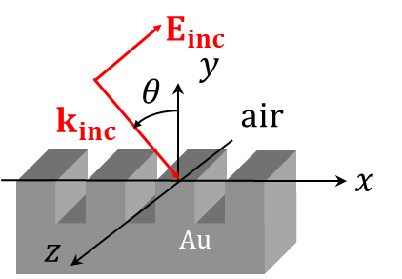
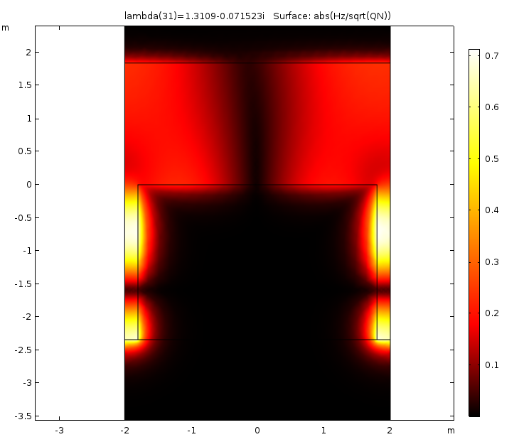
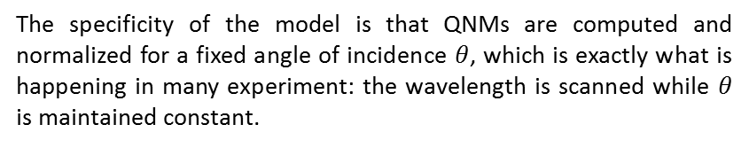
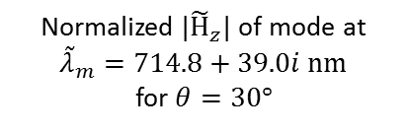

2D grating with grooves on a gold substrate with fixed incidence angle
Contact: Alexandre Gras <alexandre.gras@institutoptique.fr>
COMSOL model available on the website:
“QNMEig_grating_theta.mph’’
Ag
The specificity of the model is that QNMs are computed and normalized for a fixed angle of incidence $θ$, which is exactly what is happening in many experiment: the wavelength is scanned while $θ$ is maintained constant.
Normalized $|{\tilde{H}}_{z}|$ of mode at ${\tilde{λ}}_{m}=714.8+39.0i nm$
for $θ=30°$
$θ=30°$ incidence
A. Gras, W. Yan and P. Lalanne, Opt. Lett. 44, 3494 (2019).
"Quasinormal-mode analysis of grating spectra at fixed incidence angles"
Notes:
Developed by Wei Yan (2018)

Slide 17
Under preparation, models for
Bowtie nanoantenna on substate

